Slide 1

HADOOP PROJECT
Group Members :
Aakash Goplani
Chirag Hingorani
Rupesh Mishra

Slide 2
PROBLEM STATEMENT
Read unstructured text data and find the following: For a given phrase length of "m" words (1 <= m <= 4) and a given number "n", find the top "n" recurring phases of length "m" in the given text and the corresponding frequency count.

Slide 3
APPROACH
Approach taken was to implement a simple MapReduce Job.
The reason for this approach was:
According to given problem statement, the file has to be read and all the phrases must be extracted from it, which can be easily handled by a single Mapper.
The frequency count of top “n” recurring phrases must be displayed which can be done by a SumReducer.

Slide 4
LOGICAL FLOW
Read the file containing phrases.
Read phrases on each line.
Count unique phrases.
Count number of words in each phrase.
Output top 'n' recurring phrases consisting of 'm'(where 1 <= m <= 4) words.

Slide 5
Phrase Count ALGORITHM
PhraseDriver.java
Set the input and output directory.
Set the Main class, Mapper class and the Reducer class.
Set output key-value class.
PhraseMapper.java
Read the input file.
Accept only alphanumeric characters and remove all the special characters
Apply n-grams algorithm (where 1 <= n <= 4) to detect phrases from the given input file, line-by-line.
Pass all the derived phrases to the reducer.
PhraseReducer.java
Read all the sorted keys (phrases).
Set phraseCount = 0;
If (match found) {phraseCount++; }else {read next key}.
Output phraseCount.

Slide 6
PROBLEM FACED
The main challenge faced was to extract all the relevant phrases of length 1 to 4 from the given input file.

Slide 7
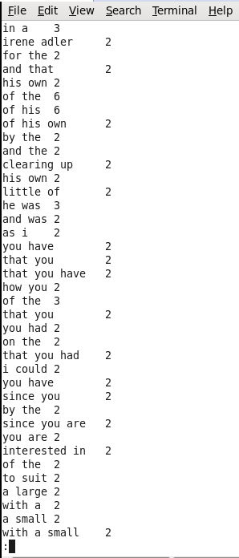
OUTPUT

Slide 8
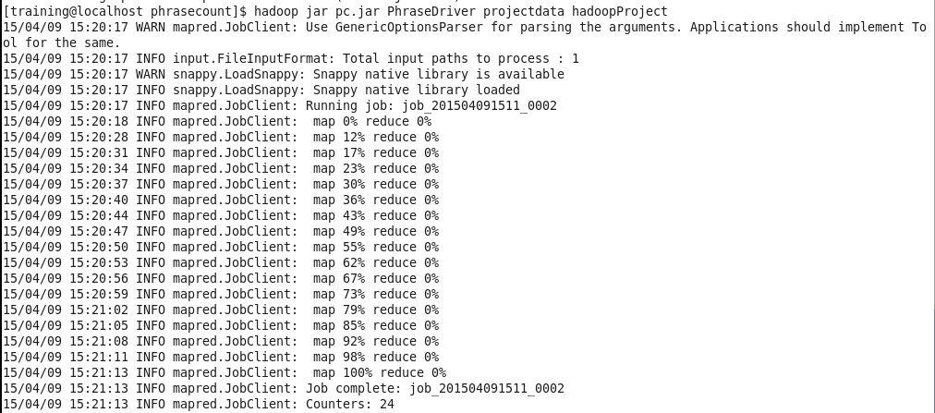
OUTPUT

Slide 9
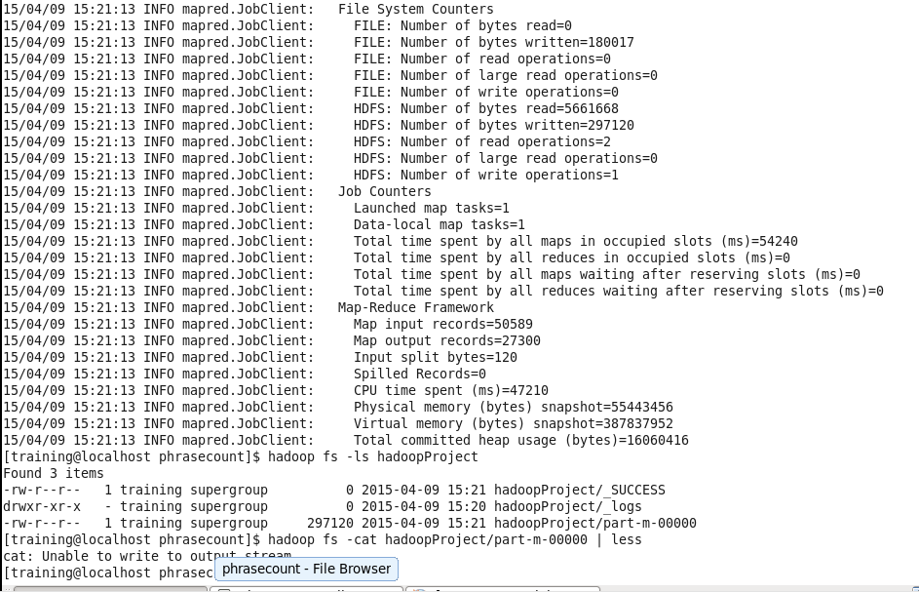
OUTPUT

Slide 10
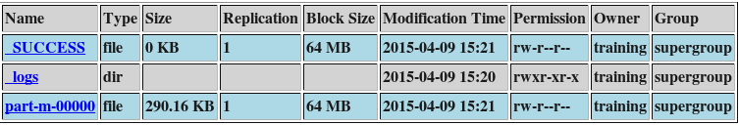
OUTPUT

Slide 11

ACKNOWLEDGEMENT
We thank Cloudera and VESIT for organizing this co-curricular course to explore Hadoop.
We are grateful to Mrs. Sujata Khedkar for giving us this opportunity to learn Hadoop.!!

Slide 12



